Slide 1
Optimizing a Neural Network
Optimizing a Neural Network or any model for that matter is like tuning a radio. The difference is there might be a million knobs to tune simultaneously. Let’s have a look at all the knobs one by one.

Slide 2
TensorBoard: TensorFlow's visualization toolkit
TensorBoard provides the visualization and tooling needed for machine learning experimentation:
Tracking and visualizing metrics such as loss and accuracy
Visualizing the model graph
Viewing histograms of weights, biases, or other tensors as they change over time
Displaying images, text, and audio data
And much more!

Slide 3
TensorBoard: TensorFlow's visualization toolkit

Slide 4
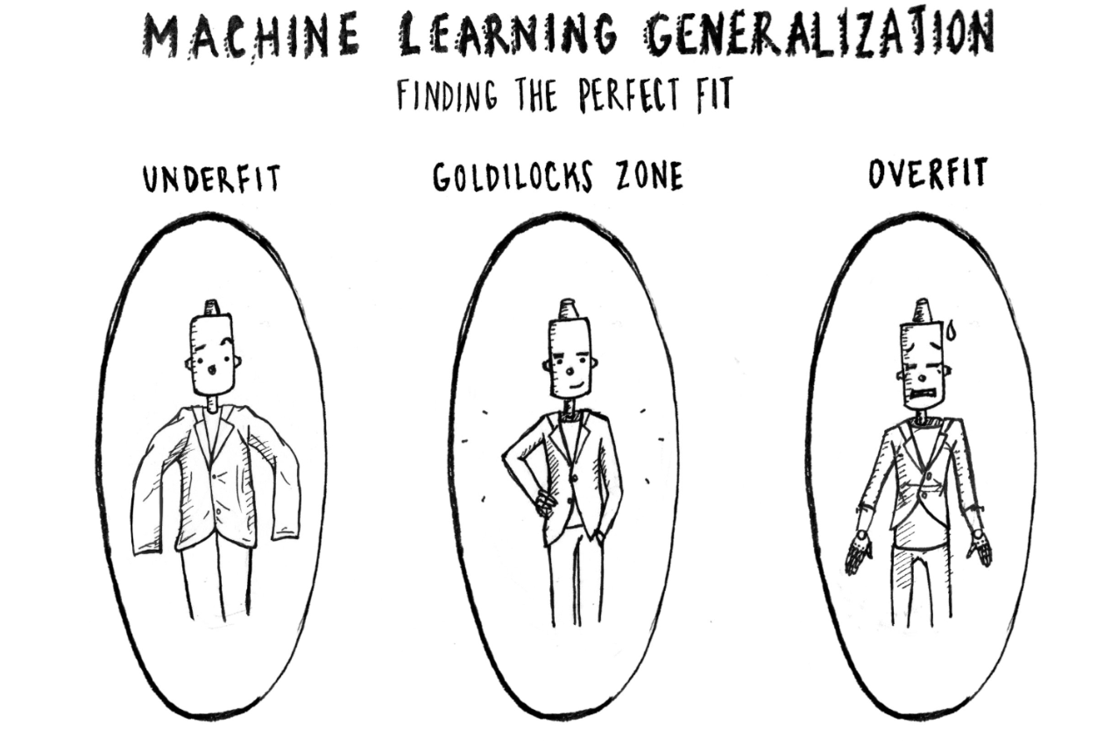
Overfitting - Underfitting

Slide 5
Overfitting
Overfitting is a scenario where your model performs well on training data but performs poorly on data not seen during training.
This basically means that your model has memorized the training data instead of learning the relationships between features and labels.
Imagine getting a ‘too good to be true’ accuracy on training data but a bad accuracy on test/validation data. That’s overfitting for you.

Slide 6
Underfitting
A machine learning algorithm is said to have underfitting when it cannot capture the underlying trend of the data.
You can think of underfitting to be the opposite of overfitting.
Overfitting learns the training data TOO well whereas Underfitting is not able to learn the data sufficiently well.
Imagine neither getting a good accuracy in training data, nor in test/validation data. That’s underfitting for you.

Slide 7
Strategies to avoid overfitting
You can combat overfitting by reducing the complexity of your model (i.e. reducing the number of parameters).This is done by :
Using fewer layers (shallower networks), fewer neurons per layer (narrow networks)
Using Dropouts
Using Regularisation
Early Stopping in some cases

Slide 8
Strategies to avoid underfitting
Underfitting is a bit harder to diagnose.
Increasing the complexity of your model i.e. increasing layers and number of neurons can help combat underfitting.
With more layers, the network can learn more sophisticated relationships and perhaps perform well on difficult real-world tasks.

Slide 9
Early Stopping
When training a large network, there will be a point during training when the model will stop generalizing and start memorizing or learning the noise in the training dataset i.e it will start overfitting which results bad performance when the model is exposed to unseen new dataset.
In other words, this overfitting of the training dataset will result in an increase in generalization error (model unable to work well on validation/test data), making the model less useful at making predictions on new data.
The challenge is to train the network long enough that it is capable of learning the mapping from inputs to outputs, but training should not be for so long that it overfits the training data.

Slide 10
Regularization
Regularization is a technique which makes slight modifications to the learning algorithm such that the model generalizes better (Generalization refers to your model's ability to adapt properly to new, previously unseen data). This in turn improves the model’s performance on the unseen data as well.
Remember when we were adding more layers to the model (making it more complex) ? Adding more than required layers might also lead to overfitting.

Slide 11
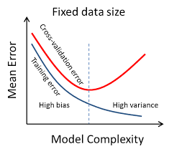
Regularization
By looking at the graph below can you guess, what should be an ideal model complexity?

Slide 12
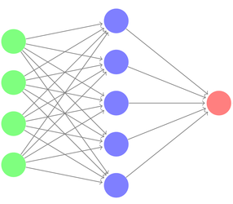
Dropout in Neural Network
You may ask what this has to do with neural network? Well, let us consider the following network…
We could think of
the input layer (in green) as the question
the host asking,
each neuron in the hidden layer (in blue)
as one person from the audience,
and the output layer (in red) as the
chosen answer from one selected
audience.
If the output layer finds out that a specific neuron is always giving the best answer, it may neglect the others and give all the weight to this neuron.

Slide 13
Dropout in Neural Network
Based on our previous analysis, we chose to forbid some neurons of answering and give chance to others. This way we will achieve balance and force all neurons to learn.
This is the concept of dropout, and technically it works as follows:
We assign a dropout rate, which represents the percentage of neurons to drop (e.g. 20% of neurons)
At each stage, we remove random neurons according to the predefined percentage.
We calculate the final output according to the combination of results from the remaining neurons.
With this technique all neurons will have the chance to vote and will be obliged to answer correctly to decrease the model loss.

Slide 14
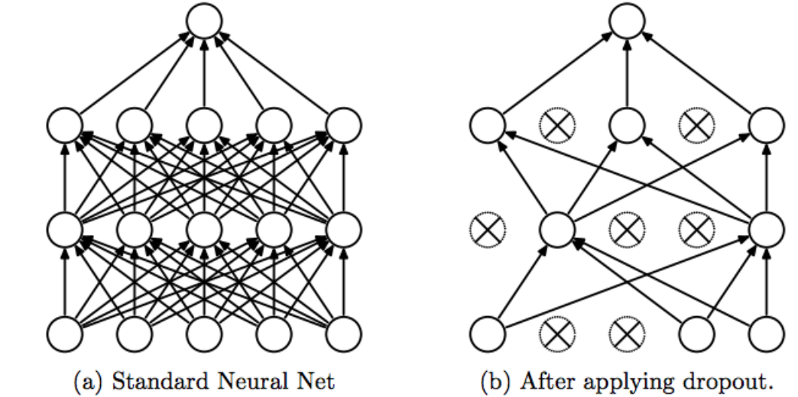
Dropout

Slide 15
Dropout
In Deep Neural Networks, the chances of overfitting are very high. Therefore, Dropout acts as a regularization to the NN. It makes the model more robust.
The percentage of neurons to be dropped is a hyperparameter that can be tuned based on the amount of overfitting on the data.
By dropping a unit out, we mean temporarily removing it from the network, along with all its incoming and outgoing connections.
It can be used with most types of layers, such as dense fully connected layers. Dropout may be implemented on any or all hidden layers in the network as well as the visible or input layer.
NOTE : It is not used on the output layer.

Slide 16
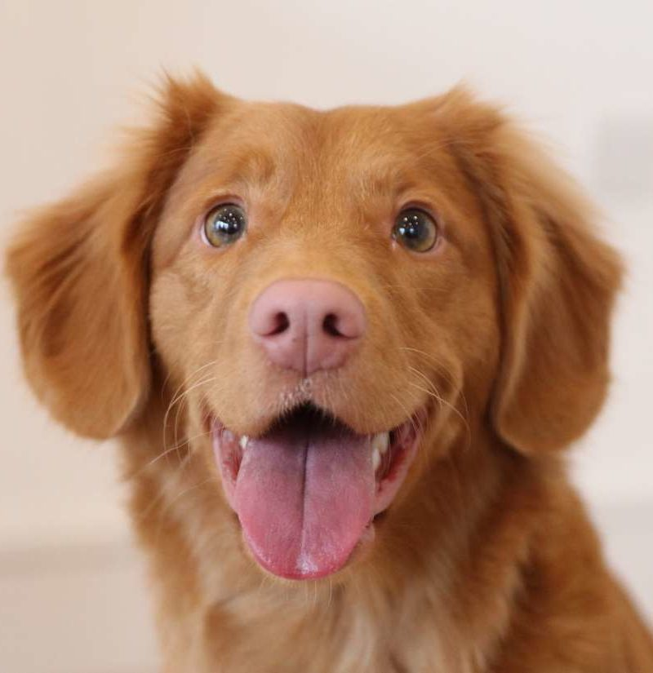
When we see this image, we can say, without even thinking, that this is an image of an adorable dog. Even an 8-year-old kid would not have any problem identifying the dog in the image.

Slide 17
Have you ever wondered how a computer sees the same image?

Slide 18
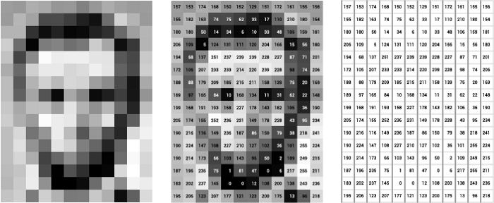
Pixel
A computer sees an image as 0s and 1s (binary digits).
Pixel is the smallest unit in an image.
Pixel data diagram. At left, image of Lincoln; at center, the pixels labeled with numbers from 0–255, representing their brightness; and at right, these numbers by themselves. What is this? 0-255, it is RGB color combination values, we will learn about it soon.

Slide 19
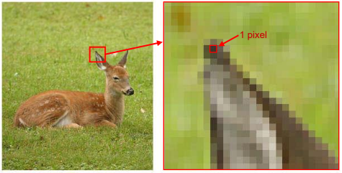
Pixel
Ear has of the animal has been zoomed to show the pixel of an image

Slide 20
Channels
Computers are actually unable to recognize or look at images the way we humans would. So, we would have to find a way to convert these images into numbers. There are two common ways to do this when it comes to Image Processing:
Greyscale - A range of grey shades from white to black.
When using the Greyscale, the computer assigns each pixel a value (in numbers) based on its level of darkness.
RGB Values - A combination of red, green, and blue.
Once a colour is given a RGB Value, the computer extracts that value from each pixel and puts the results in an array.

Slide 21
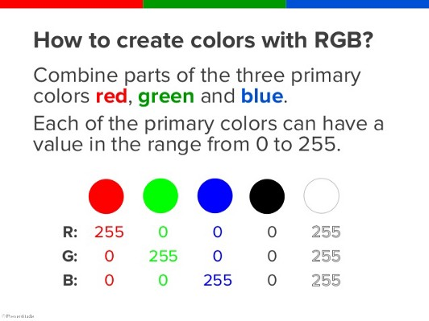
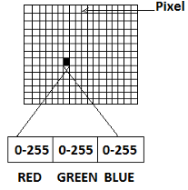
Channels

Slide 22
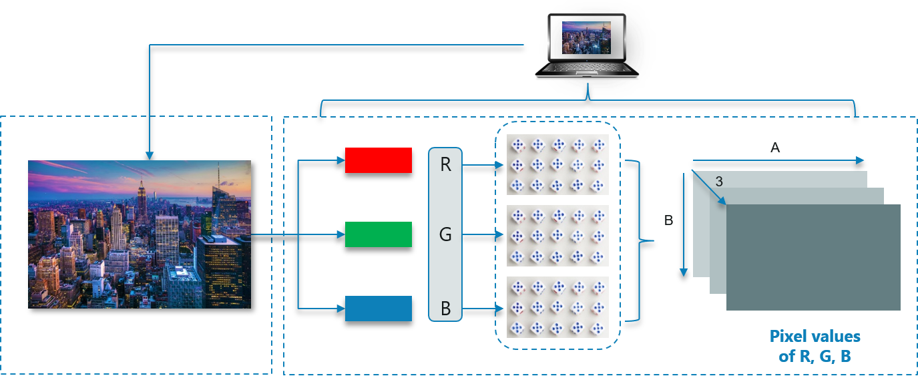
Understanding Colour Images
For any color image in RGB format, there are 3 primary channels – Red, green and blue. How it works is pretty simple.
A matrix is formed for every primary color and later these matrices combine to provide a Pixel value for the individual R, G, B colors.
Consider the following image:
Each matrix(the rectangular block) here belongs to either Red, Green or Blue. These 3 matrices combine to form 1 colour image.

Slide 23
Understanding Colour Images
Note: Images with 4, 5 or more channels also exist. An image can actually have up to 56 channels.
For example, images used in sophisticated graphics editing use four channels: three channels for RGB plus an extra alpha or "a" channel.
Also, a CMYK image has four channels: cyan, magenta, yellow, and key (black).
When we say 3 channels, we are considering images of the RGB type.

Slide 24
Image Representation
Images are usually represented as Height x Width x #Channels where #Channels is 3 for RGB images and 1 for grayscale images.
Sometimes you see Width x Height x #Channels, but the third dimension is the “channels.”

Slide 25
What is Computer Vision?
The goal of computer vision is to understand the content of digital images. Typically, this involves developing methods that attempt to reproduce the capability of human vision.

Slide 26
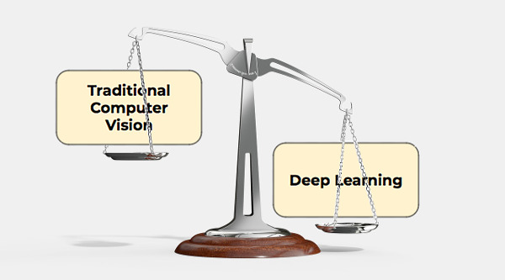
Image source: zbigatron

Slide 27
DL - The star of Computer Vision
Deep learning is a very effective method to do computer vision. In most cases, creating a good deep learning algorithm comes down to gathering a large amount of labeled training data and tuning the parameters such as the type and number of layers of neural networks and training epochs. Compared to previous types of machine learning, deep learning is both easier and faster to develop and deploy.
Most of current computer vision applications such as cancer detection, self-driving cars and facial recognition make use of deep learning. Deep learning and deep neural networks have moved from the conceptual realm into practical applications thanks to availability and advances in hardware and cloud computing resources.

Slide 28
Applications Of Computer Vision

Slide 29
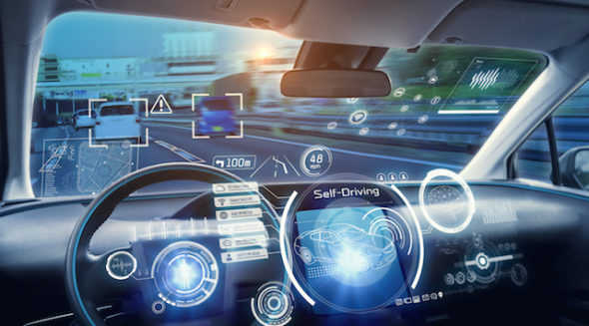
CV In Self-Driving(Autonomous) Cars
Computer vision enables self-driving cars to make sense of their surroundings. Cameras capture video from different angles around the car and feed it to computer vision software, which then processes the images in real-time to find the extremities of roads, read traffic signs, detect other cars, objects and pedestrians. The self-driving car can then steer its way on streets and highways, avoid hitting obstacles, and (hopefully) safely drive its passengers to their destination.

Slide 30
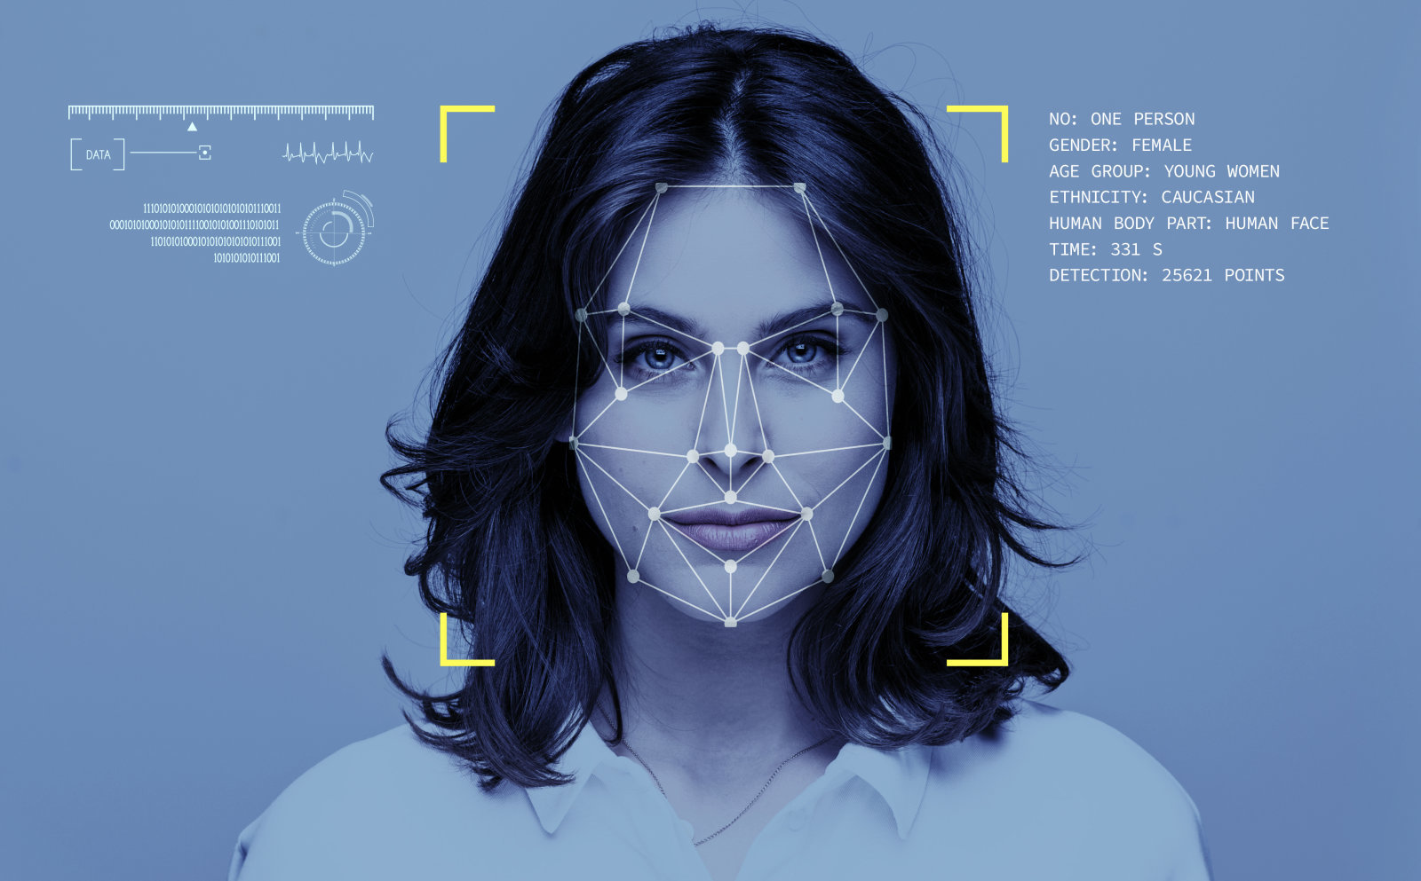
CV In Facial Recognition
Computer vision also plays an important role in facial recognition applications, the technology that enables computers to match images of people’s faces to their identities. Computer vision algorithms detect facial features in images and compare them with databases of face profiles. Consumer devices use facial recognition to authenticate the identities of their owners. Social media apps use facial recognition to detect and tag users. Law enforcement agencies also rely on facial recognition technology to identify criminals in video feeds.

Slide 31
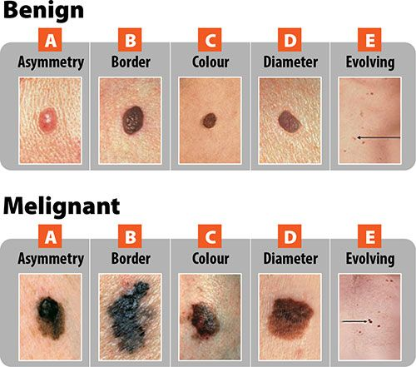
CV In Healthcare
Computer vision has also been an important part of advances in health-tech. Computer vision algorithms can help automate tasks such as detecting cancerous moles in skin images or finding symptoms in x-ray and MRI scans.

Slide 32
Computer Vision Tasks

Slide 33
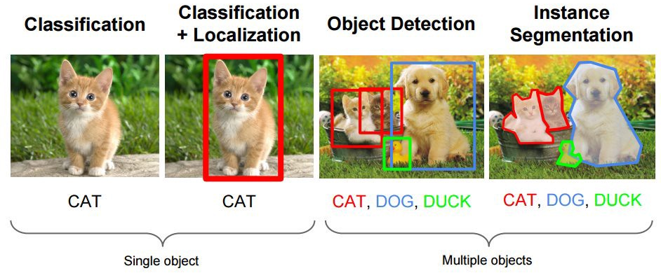
CV Tasks
Many popular computer vision applications involve trying to recognize things in photographs; for example:
Object Classification: What broad category of object is in this photograph?
Object Identification: Which type of a given object is in this photograph?
Object Verification: Is the object in the photograph?
Object Detection: Where are the objects in the photograph?
Object Landmark Detection: What are the key points for the object in the photograph?
Object Segmentation: What pixels belong to the object in the image?
Object Recognition: What objects are in this photograph and where are they?

Slide 34
CV Tasks
Outside of just recognition, other methods of analysis include:
Video motion analysis uses computer vision to estimate the velocity of objects in a video, or the camera itself.
In image segmentation, algorithms partition images into multiple sets of views.
Scene reconstruction creates a 3D model of a scene inputted through images or video.
In image restoration, noise such as blurring is removed from photos using Machine Learning based filters.
Any other application that involves understanding pixels through software can safely be labeled as computer vision.
Stating these tasks tackled by Computer Vision is not to overwhelm you but to introduce you to the immense capabilities Computer Vision holds.

Slide 35

What is OpenCV?
OpenCV (Open Source Computer Vision) is a library with functions that mainly aim at real-time computer vision. OpenCV supports Deep Learning frameworks like Caffe, Tensorflow, Torch/PyTorch.

Slide 36
Role of OpenCV in a deep learning computer vision project
OpenCV is not used to train the neural networks—you should do that with a framework like TensorFlow or PyTorch, and then export the model to run in OpenCV.
OpenCV is used to take a trained neural network model, prepare and preprocess images for it, apply it to the images and output results. You can also use it to combine neural networks with other computer vision algorithms available in OpenCV.

Slide 37
OpenCV Applications
Detecting and recognizing faces
Identifying objects
Classifying human actions in videos
Tracking camera movements
Tracking moving objects
Extracting 3D models of objects
Producing 3D point clouds from stereo cameras
Stitching images together to produce an image of a scene
Finding similar images from an image database
Removing red eyes from images
Following eye movements
Recognizing scenery adding markers to enable augmented reality (AR)
And many more.

Slide 38
Colour images in OpenCV
In OpenCV color images in the RGB (Red, Green, Blue) color space have a 3-tuple associated with each pixel: (B, G, R) .
Notice the ordering is BGR rather than RGB. This is because when OpenCV was first being developed many years ago the standard was BGR ordering. Over the years, the standard has now become RGB but OpenCV still maintains this “legacy” BGR ordering to ensure no existing code breaks.

Slide 39
Installing OpenCV
Before you can start learning OpenCV you first need to install the OpenCV library on your system.
If you are working on Jupyter notebook in your device, you can install OpenCV with:
pip install opencv-python
Colab users don’t need to worry about this. OpenCV is installed by default in Google Colab.

Slide 40
Basic OpenCV Operations in practice
The following notebook elaborates on the most commonly used commands in OpenCV:
https://github.com/dphi-official/Deep_Learning_Bootcamp/blob/master/OpenCV/DL_Day12_OpenCV.ipynb

Slide 41
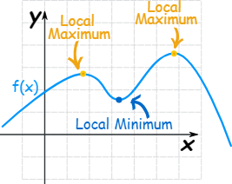
Local Minima and Maxima
Functions can have "hills and valleys": places where they reach a minimum or maximum value.
It may not be the minimum or maximum for the whole function, but locally it is.

Slide 42
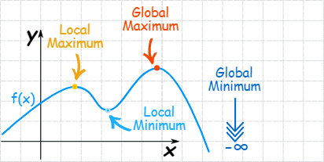
Global Minima and Maxima
The maximum or minimum over the entire function is called an "Absolute" or "Global" maximum or minimum.
There is only one global maximum (and one global minimum) but there can be more than one local maximum or minimum.

Slide 43
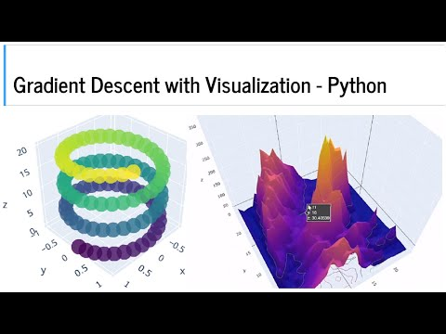
Global and Local Minima

Slide 44
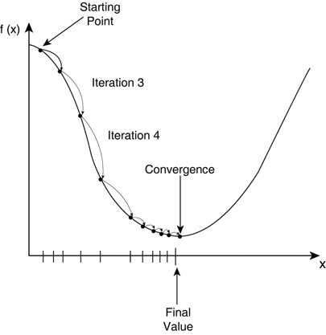
Convergence of Cost Function
As you might remember, cost function is minimized by gradient descent. Gradient descent is an efficient optimization algorithm that attempts to find a local or global minima of a function.
You might’ve heard ‘repeat the process
of Gradient Descent (GD) until convergence’.
But what is exactly convergence?
Reaching a point in which GD makes very small changes in your cost function is called convergence, which doesn't necessarily mean it has reached the optimal result (but it is really quite near, if not on it).
At the minima point, the model has
optimized the weights such that they
minimize the cost function.

Slide 45
The `local minima' problem
We try to reduce to the loss function for any given problem.
The best model is obtained at global minimum i.e. where the loss is minimum. However, It is quite difficult to reach a global minima because in trainings we sometimes get stuck in local minimas.
The real challenge lies in skipping the local minima to achieve global minima and that is when you hit gold.

Slide 46
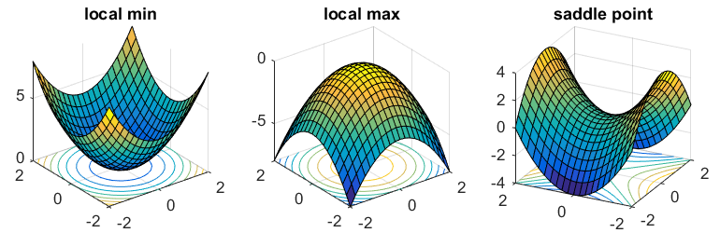
Saddle Point
It is nowadays being discussed that saddle points are in fact a more serious concern than local minima.
Now, What are saddle points? Look at the image below, Saddle points are the points lying at the center of the image on the right.
The name is inspired by the shape which is similar to a Horse saddle.
Saddle Point

Slide 47
Batch Size
Batch size is one of the most important hyperparameters in deep learning training, and it represents the number of samples used in one forward and backward pass through the network and has a direct impact on the accuracy and computational efficiency of the training process. The batch size can be understood as a trade-off between accuracy and speed.
Large batch sizes can lead to faster training times but may result in lower accuracy and overfitting, while smaller batch sizes can provide better accuracy, but can be computationally expensive and time-consuming.

Slide 48
Batch Size
The batch size can also affect the convergence of the model, meaning that it can influence the optimization process and the speed at which the model learns. Small batch sizes can be more susceptible to random fluctuations in the training data, while larger batch sizes are more resistant to these fluctuations but may converge more slowly.
It is important to note that there is no one-size-fits-all answer when it comes to choosing a batch size, as the ideal size will depend on several factors, including the size of the training dataset, the complexity of the model, and the computational resources available.
1000/10 = 100 batches per epoch

Slide 49
Batch Gradient Descent
In Batch Gradient Descent, all the training data is taken into consideration to take a single step. We take the average of the gradients of all the training examples and then use that mean gradient to update our parameters. So that’s just one step of gradient descent in one epoch.
Batch Gradient Descent is great for relatively smooth error function curves. In this case, we move somewhat directly towards an optimum solution.

Slide 50
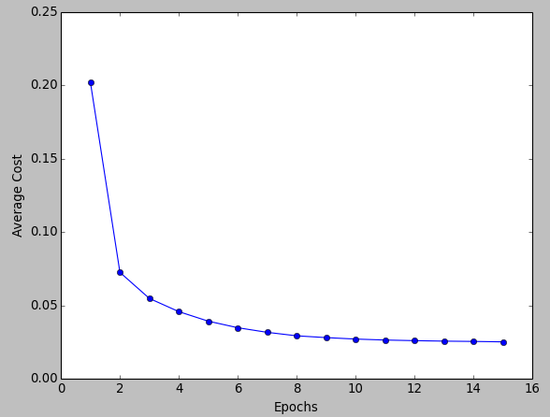
Batch Gradient Descent
The graph of cost vs epochs is also quite smooth because we are averaging over all the gradients of training data for a single step. The cost keeps on decreasing over the epochs.
Look at how smooth the graph is. It is because we are taking an average of gradients before taking a step.

Slide 51
Problem with Batch Gradient Descent
In Batch Gradient Descent we were considering all the examples for every step of Gradient Descent.
But what if our dataset is very huge? Deep learning models crave for data. The more the data the more chances of a model to be good.
Suppose our dataset has 5 million examples, then just to take one step the model will have to calculate the gradients of all the 5 million examples! This does not seem an efficient way.
In short, since we need to calculate the gradient on the whole dataset to perform just one update, batch gradient descent can be very slow.

Slide 52
Stochastic Gradient Descent (SGD)
Batch Gradient Descent turns out to be a slower algorithm. So, for faster computation, we prefer to use stochastic gradient descent.
The first step of algorithm is to randomize (shuffle) the whole training set.
Then, for updation of every parameter we use only one training example in every iteration to compute the gradient of cost function.
As it uses one training example in every iteration this algo is faster for larger data set. Still confused why? It is because the network no longer needs to process a number of examples(a batch) together at a time before making a weight update. It can quickly process 1 example, make an update and then move to the next.
In SGD, one might not achieve the best accuracy, but the computation of results are faster.

Slide 53
Stochastic Gradient Descent
We do the following steps in one epoch for SGD:
Take an example
Feed it to Neural Network
Calculate it’s gradient
Use the gradient we calculated in step 3 to update the weights
Repeat steps 1–4 for all the examples in training dataset

Slide 54
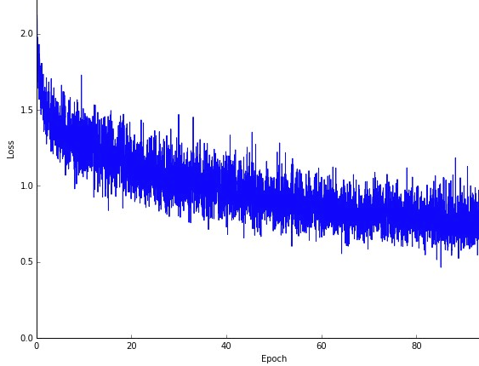
Stochastic Gradient Descent
Since we are considering just one example at a time the cost will fluctuate over the training examples and it will not necessarily decrease. But in the long run, you will see the cost decreasing with fluctuations.
Also because the cost is so fluctuating, it will never reach the minimum but it will keep dancing around it.
SGD can be used for larger datasets. It converges faster when the dataset is large as it causes updates to the parameters more frequently.
Observe how the graph is not so smooth here. It is because much more updates are happening here than in Batch GD.

Slide 55
Advantages of Stochastic Gradient Descent
1. It is easier to fit into memory due to a single training sample being processed by the network at a time.
2. It is computationally fast as only one sample is processed at a time.
3. For larger datasets it can converge faster as it causes updates to the parameters more frequently.
4. Due to frequent updates the steps taken towards the minima of the loss function have oscillations which can help getting out of local minimums of the loss function (in case the computed position turns out to be the local minimum).

Slide 56
Best of both worlds
We have seen the Batch Gradient Descent. We have also seen the Stochastic Gradient Descent.
Batch Gradient Descent can be used for smoother curves. SGD can be used when the dataset is large.
Batch Gradient Descent converges directly to minima. SGD converges faster for larger datasets.
But, since in SGD we use only one example at a time, it can slow down the computations.
To tackle this problem, a mixture of Batch Gradient Descent and SGD is used. It is known as Mini-batch Gradient Descent.

Slide 57
Mini-batch Gradient Descent
Neither we use all the dataset all at once nor we use the single example at a time. We use a batch of a fixed number of training examples which is less than the actual dataset and call it a mini-batch. Doing this helps us achieve the advantages of both the former variants we saw.
So, after creating the mini-batches of fixed size, we do the following steps in one epoch:
Pick a mini-batch
Feed it to Neural Network
Calculate the mean gradient of the mini-batch
Use the mean gradient we calculated in step 3 to update the weights
Repeat steps 1–4 for the mini-batches we created

Slide 58
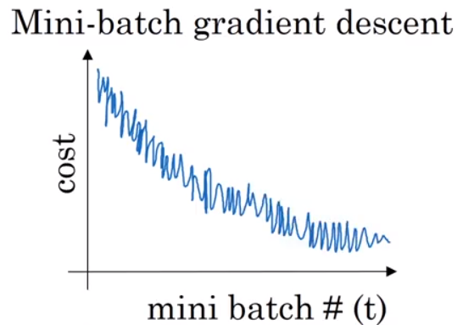
Mini-batch Gradient Descent
Just like SGD, the average cost over the epochs in mini-batch gradient descent fluctuates because we are averaging a small number of examples at a time.
So, when we are using the mini-batch gradient descent we are updating our parameters frequently as well for faster computations.
This graph is somewhere between BGD and SGD. It’s neither too smooth, nor too fluctuating

Slide 59
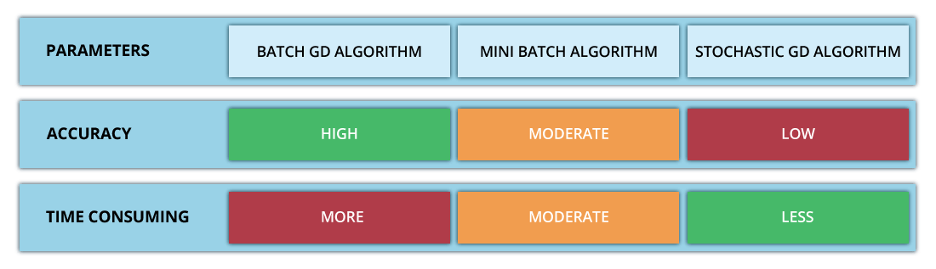
Summary
Summarising the 3 Gradient Descent Techniques:

Slide 60
Vanishing and Exploding Gradients
Remember how we didn’t use Sigmoid or Softmax in the hidden layers and used ReLU instead? Now you’ll understand why.
In case of sigmoid and tanh activation functions, if your weights are large, then the gradient will be very (vanishingly) small, effectively preventing the weights from changing their value. This is because the derivative of weights will increase very slightly or possibly get smaller and smaller every iteration.
Using RELU/ leaky RELU as the activation function is a better choice, as it is relatively robust to the vanishing/exploding gradient issue (especially for networks that are not too deep).
Leaky ReLUs ( a variation of ReLU Activation Function) never have 0 gradient. Thus they never die and training continues.

Slide 61
Weight Initialization
While starting the training of neural nets these parameters (typically the weights) are initialized in a number of different ways -
sometimes, using constant values like 0’s and 1’s,
sometimes with values sampled from some distribution (typically a uniform distribution or normal distribution),
sometimes with other sophisticated schemes like Xavier Initialization.
You’ll understand all of these in some time.

Slide 62
Importance of Weight Initialization
The weight initialization technique you choose for your neural network can determine how quickly the network converges or whether it converges at all. Although the initial values of these weights are just one parameter among many to tune, they are incredibly important. Their distribution affects the gradients and, therefore, the effectiveness of training.
This phenomena is largely due to the characteristics of activation functions.
The aim of weight initialization is to prevent layer activation outputs from exploding or vanishing during the course of a forward pass through a deep neural network. If either occurs, loss gradients will either be too large or too small to flow backwards beneficially, and the network will take longer to converge, if it is even able to do so at all.

Slide 63
Importance of Weight Initialization
Careful initialization of weights not only helps us to develop more reproducible neural nets but also it helps us in training them better.
Symmetry breaking is a common term you’ll encounter here. It simply means that all the neurons shouldn’t learn the exact same thing. Only if they are able to learn different features (are not completely symmetrical) that the model will be able to perform better.
Let us talk about 2 basic weight initialization techniques and how they can cause issues while training the model:

Slide 64
Zero initialization
Zero initialization serves no purpose. The neural net does not perform symmetry-breaking.
If we set all the weights to be zero, then all the the neurons of all the layers performs the same calculation, giving the same output and there by making the whole deep net useless.
If the weights are zero, complexity of the whole deep net would be the same as that of a single neuron and the predictions would be nothing better than random i.e it won’t perform good at all.
Weights can be initialised to 1 too. That does perform better than initializing them to 0 but is still not able to break symmetry and perform well.

Slide 65
2. Random initialization
This serves the process of symmetry-breaking and gives much better accuracy. In this method, the weights are initialized very close to zero, but randomly. This helps in breaking symmetry and every neuron is no longer performing the same computation.
However, initializing weights randomly while working with a deep network can potentially lead to 2 issues — vanishing gradients or exploding gradients.

Slide 66
Key points to remember for weight initialization
Weights should be small (not too small, medium small)
Large weights cause exploding gradients, specially while using sigmoid activation function.
Weights should not be same
Same weights will prevent neural network from learning new features.
Weights should have good variance
This will help each of the neuron to learn new features.

Slide 67
Other Weight Initializations
Here comes the other weight initialization techniques. Based on the previous key points, they try to tackle the problems with the basic initialization techniques and perform better, particularly in the case of deep neural networks.

Slide 68
He init initialization
In this method, the weights are initialized keeping in mind the size of the previous layer which helps in attaining a global minimum of the cost function faster and more efficiently.
The weights are still random but differ in range depending on the size of the previous layer of neurons. This provides a controlled initialisation hence the faster and more efficient gradient descent.

Slide 69
Xavier/Glorot initialization
In short, Xavier Initialization helps signals reach deep into the network.
If the weights in a network start too small, then the signal shrinks as it passes through each layer until it’s too tiny to be useful.
If the weights in a network start too large, then the signal grows as it passes through each layer until it’s too massive to be useful.
Xavier initialization makes sure the weights are ‘just right’, keeping the signal in a reasonable range of values through many layers.

Slide 70
More initializers
Some more commonly used initializers include:
Uniform initializer
Kaiming initializer

Slide 71
Initializers in practice
The below article shows how initializers can be implemented in Tensorflow Keras:
https://keras.io/api/layers/initializers/
A list of all initializers provided by Tensorflow Keras:
https://www.tensorflow.org/api_docs/python/tf/keras/initializers
NOTE: One major thing to keep in mind is that the real benefit of using different initializers is only in the case of Deep Neural Networks where the problem of Vanishing/Exploding gradients can occur. Otherwise, you might not be able to see much performance improvement.

Slide 72
INTERESTING READ
A great article on Weight Initialization that studies the effects of different weight initialization schemes on a toy dataset. You can play with different initializers here and see how they work:
https://www.deeplearning.ai/ai-notes/initialization/
PS. There’s no need to focus on the maths part

Slide 73
Until now you’ve worked with Multi Layer Perceptrons(MLP).
MLPs are great for MNIST - a simpler more straight forward dataset but lag behind CNNs when it comes to real world application in computer vision, specifically image classification.
The concepts that make CNN’s so great are not complex but are very intuitive, logical and easy to understand.

Slide 74
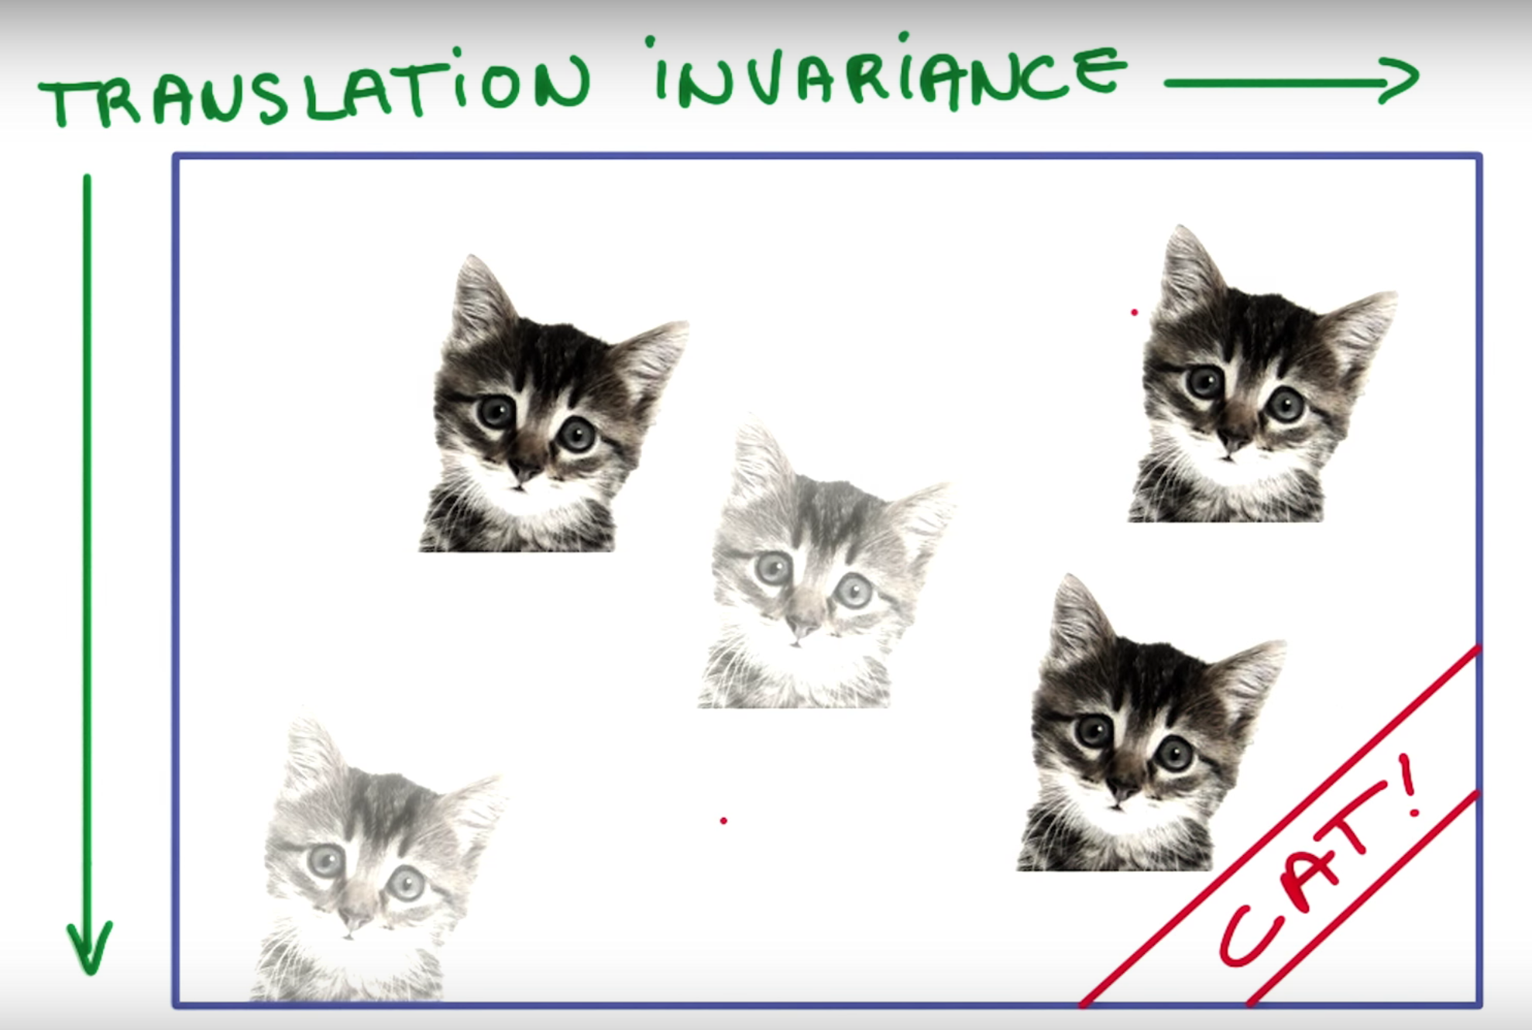
Spatial/Translation Invariance
Spatial or Translation Invariance means that if an object occurs in any image it will be detected irrespective of its position in the image.
A cat is still a cat regardless of whether it appears in the top half or the bottom half of the image.

Slide 75
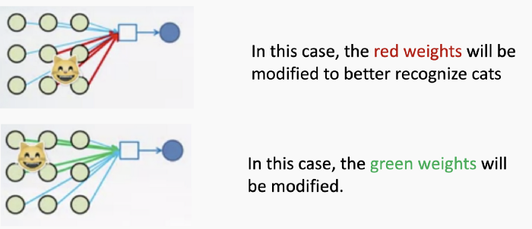
Disadvantages of MLP
Need to connect neuron in hidden layer to ALL the neurons in input layer
No spatial information: Since we reshape the image from 2D to 1D, it doesn’t really understand the spatial structure of the image i.e it is not spatially invariant. For example, if a picture of a cat appears in the top left of the image in one picture and the bottom right of another picture, the MLP will try to correct itself and assume that a cat will always appear in this section of the image.
And many, many parameters to be handled. MLPs use one perceptron for each input (e.g. pixel in an image, multiplied by 3 in RGB case). The amount of weights rapidly becomes unmanageable for large images. For a 224 x 224 pixel image with 3 color channels there are around 150,000 weights that must be trained!
A cat detector using an MLP which changes as the position of the cat changes.

Slide 76
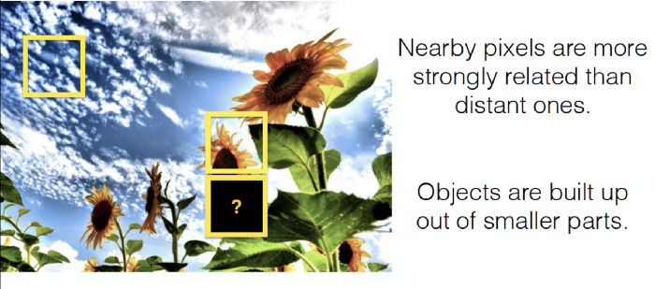
Enters the Convolutional Neural Network
Convolutional Neural Networks are designed to be spatially invariant, that is - they are not sensitive to the position of object in the picture. The cat can be anywhere in the image and it’ll still recognise it!
But what if the image doesn’t just consist of a cat? What if there are more features? Will flipping the image confuse the CNN? No, a CNN will still work fine!
CNN’s take advantage of the fact that nearby pixels are more strongly related than distant ones. So a pixels around sky will still be a sky and pixels near sunflower have more chances of being a sunflower.

Slide 77
Convolutional Neural Network/ ConvNet/ CNN
To teach an algorithm how to recognise objects in images, we use a specific type of Artificial Neural Network: a Convolutional Neural Network (CNN). Their name stems from one of the most important operations in the network: convolution.
The word convolution refers to the filtering process that happens in this type of network. In literal terms, it is a mathematical operation that makes filtering possible.

Slide 78
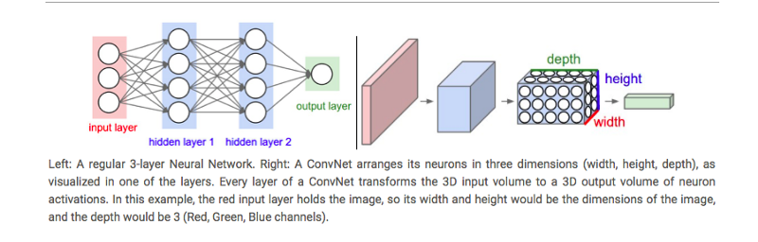
Comparison of Architectures - CNN and ANN/MLP
Regular Neural Networks:
Transform an input by putting it through a series of hidden layers.
Every layer is made up of a set of neurons, where each layer is fully connected to all neurons in the layer before.
Finally, there is a last fully-connected layer — the output layer — that represent the predictions.
In CNNs :
The layers are organised in 3 dimensions: width, height and depth.
The neurons in one layer do not connect to all the neurons in the next layer but only to a small region of it.

Slide 79
CNN Working

Slide 80
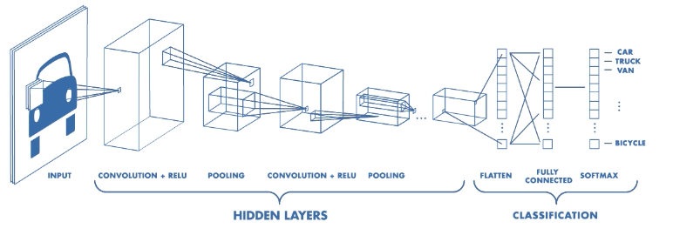
CNN Components
CNNs have two components:
The Hidden layers/Feature extraction part
In this part, the network will perform a series of operations during which the features are detected. If you had a picture of a zebra, this is the part where the network would recognise its stripes, two ears, and four legs.
The Classification part
This part assigns a probability of the object(eg. The zebra) being in that image.

Slide 81
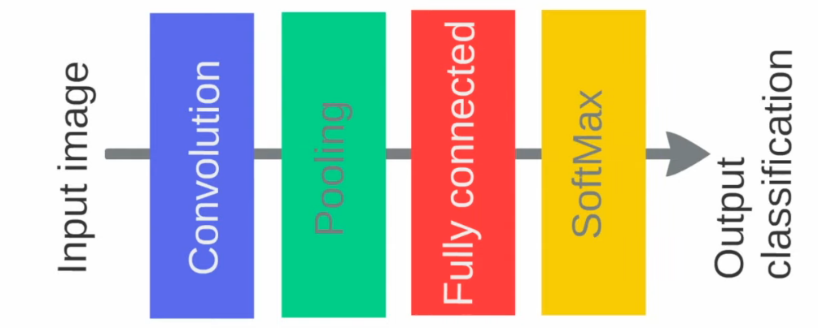
A basic CNN architecture
Below is the basic order of operations in a CNN. The Convolution and Pooling operations can occur multiple times in a CNN, the order will however remain the same. They’ll always be succeeded by Fully Connected and Softmax/Sigmoid layer.

Slide 82
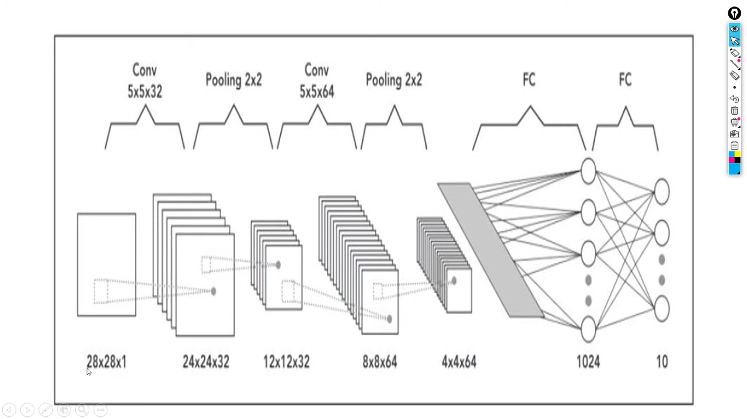
Convolution

Slide 83
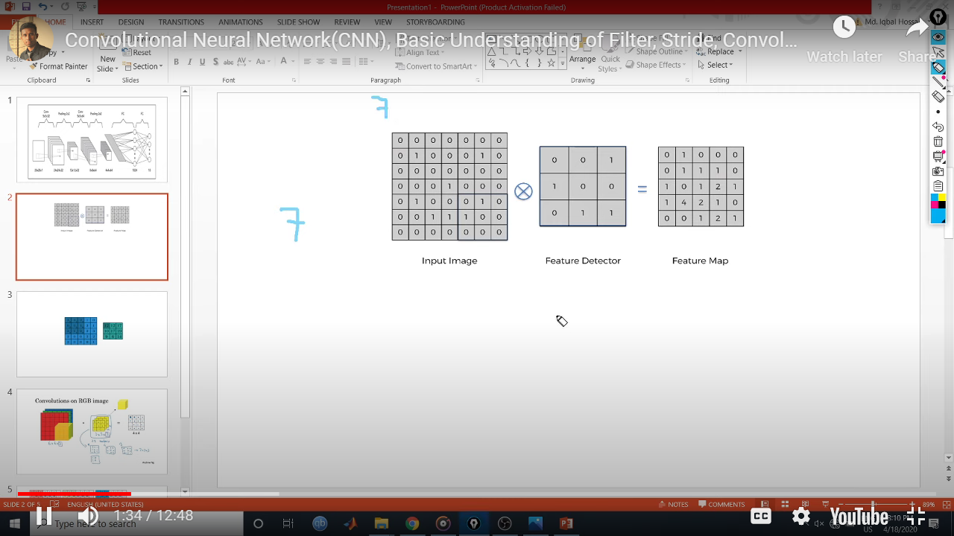
Example
Notes:
Stride = step size

Slide 84
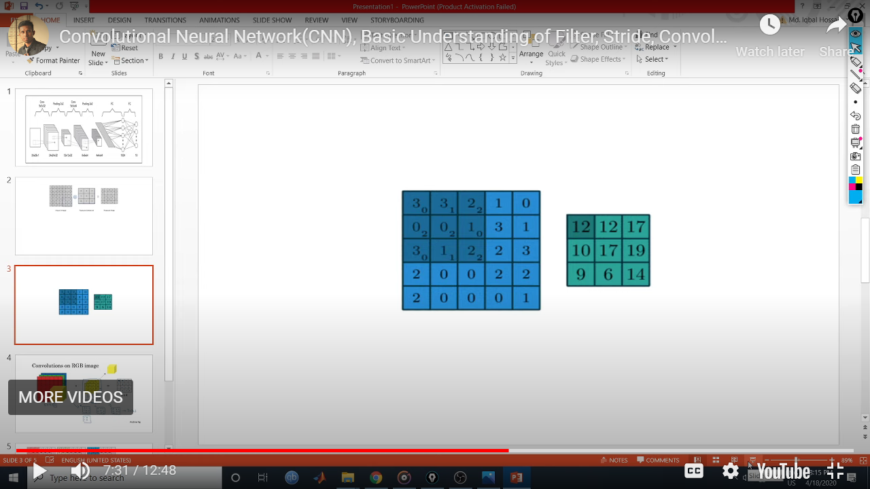
Example 2

Slide 85
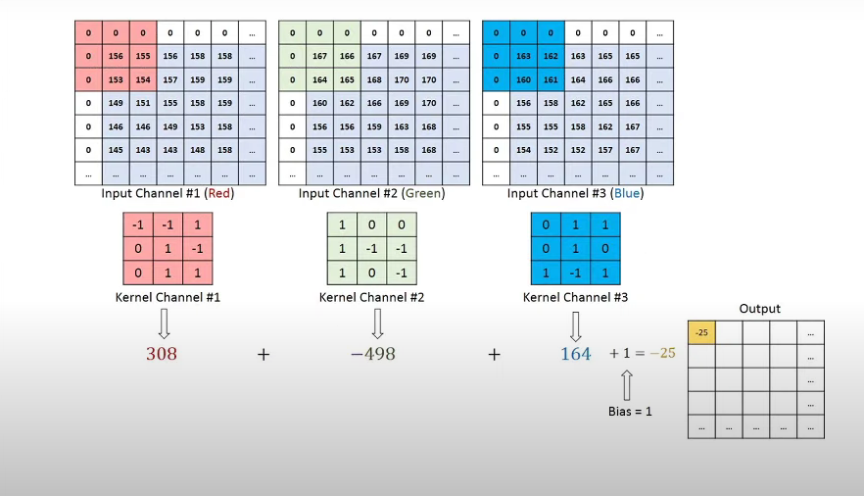
Example 3

Slide 86
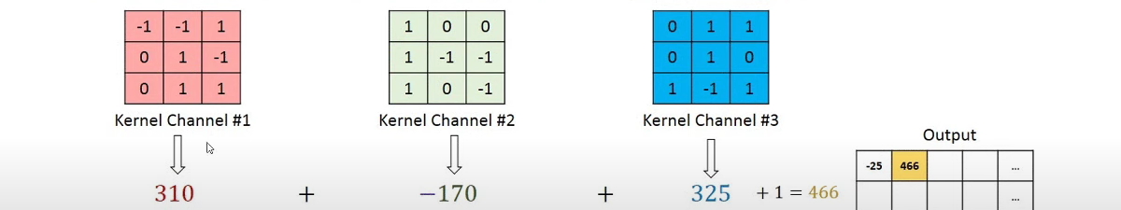
Example 3

Slide 87
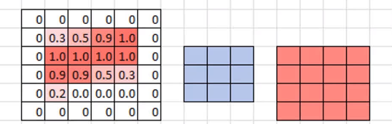
Zero Padding
Zero padding occurs when we add a border of pixels all with value zero around the edges of the input images. This adds kind of a padding of zeros around the outside of the image, hence the name zero padding. Going back to our small example from earlier, if we pad our input with a border of zero-valued pixels, let's see what the resulting output size will be after convolving our input..
Notes:
ValidNo paddingDimensions reduceSameZeros around the edgesDimensions stay the same

Slide 88
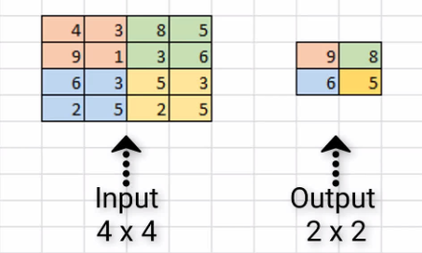
Max Pooling
Max pooling is a type of operation that is typically added to CNNs following individual convolutional layers.
When added to a model, max pooling reduces the dimensionality of images by reducing the number of pixels in the output from the previous convolutional layer.
Notes:
Reducing Computational Load
Max pooling: The maximum pixel value of the batch is selected. Min pooling: The minimum pixel value of the batch is selected. Average pooling: The average value of all the pixels in the batch is selected.
Reducing Overfitting

Slide 89
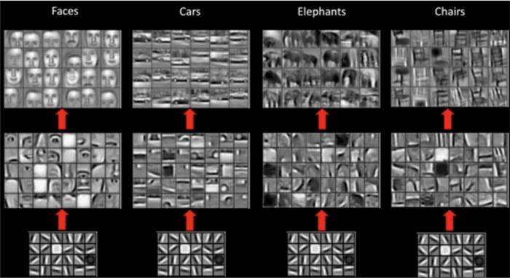
What do CNN layers learn?
Each CNN layer learns filters of increasing complexity.
The first layers learn basic feature detection filters: edges, corners, etc
The middle layers learn filters that detect parts of objects. For faces, they might learn to respond to eyes, noses, etc
The last layers have higher representations: they learn to recognize full objects, in different shapes and positions.

Slide 90
What do CNN layers learn?
The earlier features of a ConvNet contain more generic features (e.g. edge detectors or color blob detectors), but later layers of the ConvNet becomes progressively more specific to the details of the classes contained in the original dataset.

Slide 91
How to use Deep Learning when you have Limited Data

Slide 92
The problem of Limited Data
“The analogy to deep learning is that the rocket engine is the deep learning models and the fuel is the huge amounts of data we can feed to these algorithms.” — Andrew Ng
There has been a recent surge in popularity of Deep Learning, achieving state of the art performance in various tasks like Language Translation, playing Strategy Games and Self Driving Cars requiring millions of data points.
One common barrier for using deep learning to solve problems is the amount of data needed to train a model. The requirement of large data arises because of the large number of parameters in the model that machines have to learn.
So what do you do when while working on a problem, you’re unable to find the required amount of data?

Slide 93
Transfer Learning to the Rescue!
“If Deep Learning is the holy grail and data is the gatekeeper, transfer learning is the key.”

Slide 94
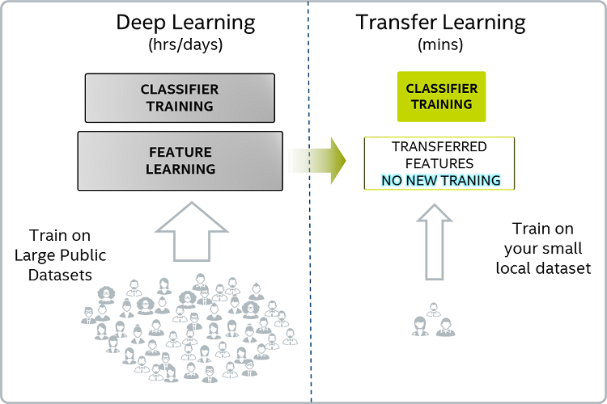
Transfer Learning
Transfer learning make use of the knowledge gained while solving one problem and applying it to a different but related problem.
For example, knowledge gained while learning to recognize cars can be used to some extent to recognize trucks.

Slide 95
Transfer Learning
Pre-training
When we train a network on a large dataset(for example: ImageNet) , we train all the parameters of the neural network and therefore the model is learned. It may take hours on your GPU to train on such a large dataset. This model is known as a Pre-trained model.
Fine Tuning
We can give the new dataset to fine tune the pre-trained CNN. Consider that the new dataset is almost similar to the original dataset used for pre-training. Since the new dataset is similar, the same weights can be used for extracting the features from the new dataset.
If the new dataset is very small, it’s better to train only the final layers of the network to avoid overfitting, keeping all other layers fixed. So remove the final layers of the pre-trained network. Add new layers . Retrain only the new layers.
If the new dataset is very much large, retrain the whole network with initial weights from the pretrained model.

Slide 96
Transfer Learning
Another major advantage of using transfer learning is how well the model generalizes.
Larger models tend to overfit the data and don’t work as well when you test it out on unseen data. Since transfer learning allows the model to see different types of data, it learns underlying rules of the world better.

Slide 97
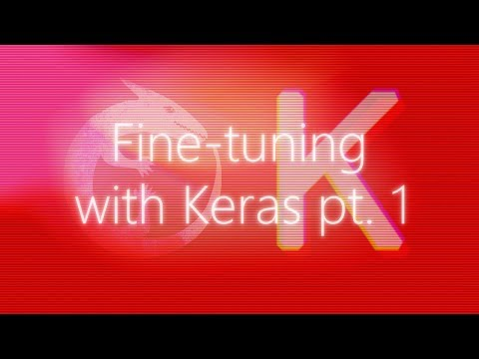
Transfer Learning
You can have a look at this video if you’re interested to learn how Transfer Learning is performed. It’s a slightly advance topic so don’t worry if you don’t get it in the first go. Also, the instructor is using Keras but the same code will work with tf.Keras as well.

Slide 98
2. Data Augmentation

Slide 99
Data Augmentation
To get more data, we just need to make minor alterations to our existing dataset. Minor changes such as flips or translations or rotations. Our neural network would think these are distinct images anyway.
A convolutional neural network that can robustly classify objects even if its placed in different orientations is said to have the property called invariance. More specifically, a CNN can be invariant to translation, viewpoint, size or illumination (Or a combination of the above).
This essentially is the premise of data augmentation. In the real world scenario, we may have a dataset of images taken in a limited set of conditions. But, our target application may exist in a variety of conditions, such as different orientation, location, scale, brightness etc. We account for these situations by training our neural network with additional synthetically modified data.
It is also one of the methods to prevent overfitting!

Slide 100
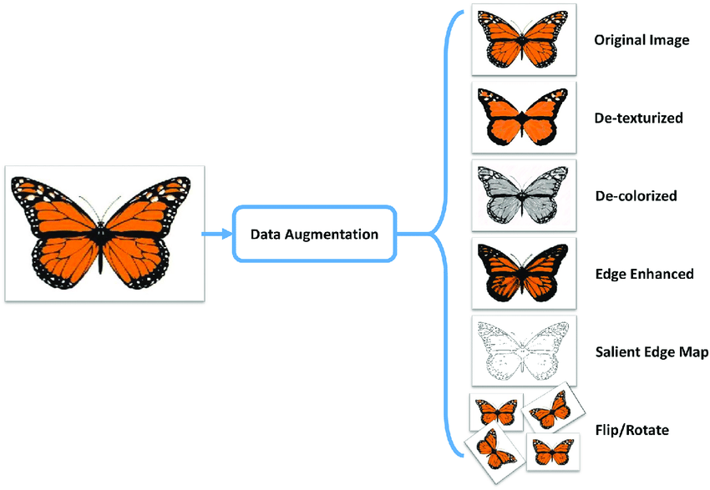
Data Augmentation
Your neural network is only as good as the data you feed it.
By performing augmentation, can prevent your neural network from learning irrelevant patterns, essentially boosting overall performance.
Your model for detecting a butterfly should be able to find a butterfly in the image even if it is flying sidewards, right?

Slide 101
Popular Augmentation Techniques on images
Flip - horizontally/vertically
Rotation
Scale
Crop
Translation
Varying Color
Adding noise
Adjusting brightness
Apart from the above, many more augmentation techniques exist.

Slide 102
Where to perform Data Augmentation?
Data Augmentation is usually performed on Train Set and often Validation Set as well. This is because we want to increase the size and variety of data our model learns from.
However, Data Augmentation can also be performed on Test Set. It is not to make the test data bigger/more accurate, but just to make the input data from the test set resemble that of the input data from the training set, so we can feed it into the same net (eg same dimensions).
For example, in image cropping, we'd need to crop the test images too, so they are of a similar size as the training images.

Slide 103
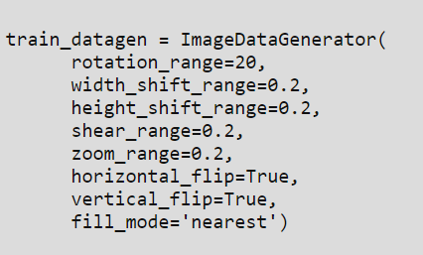
How to perform Data Augmentation?
A Tensorflow Keras function called ImageDataGenerator helps in performing Data Augmentation techniques.
An ImageDataGenerator which performs augmentation might look like this:
Look at the variety of augmentation operations available!
Note: Apart from ImageDataGenerator, there exist multiple other options of performing Data Augmentation as well.

Slide 104
Batch Normalization
Making models faster and more stable

Slide 105
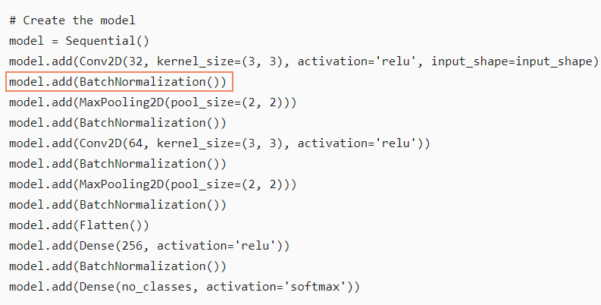
Batch Normalization: How?
Applying Batch Normalization is as simple as adding a layer called BatchNormalization() after the convolution layer. It can be added to any Neural Network.

Slide 106
Additional Material
A nice article throwing light on the variety of Data Augmentation techniques in practice:
https://towardsdatascience.com/exploring-image-data-augmentation-with-keras-and-tensorflow-a8162d89b844

